Slide 1
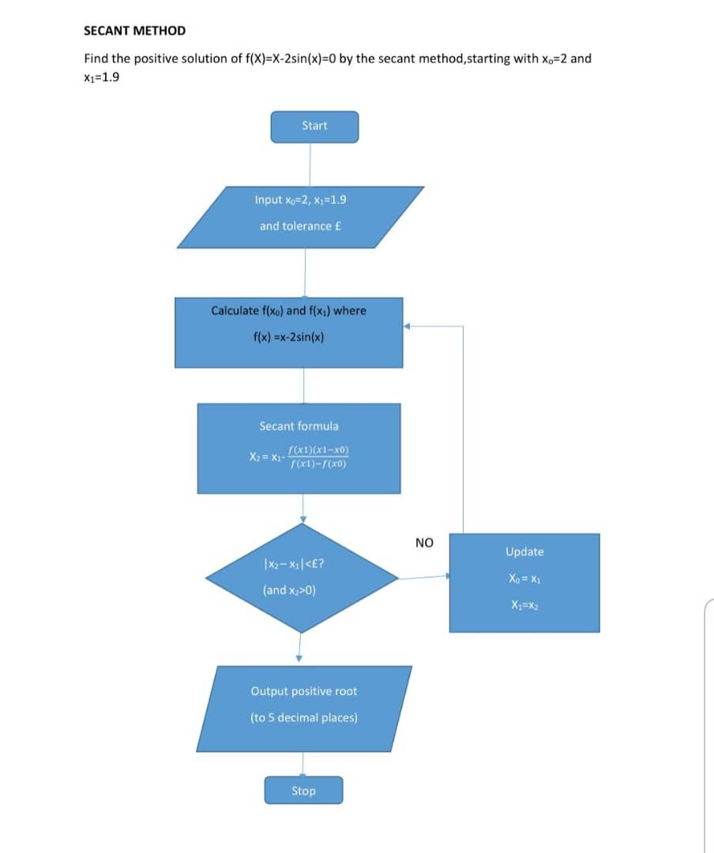
SECANT METHOD

Slide 2
PSEUDOCODE
START
Define f(x)=x-2sin(x)
Set x₀=2
Set x₁=1.9
Set tolerance £
REPEAT
Calculate f(x₀) Calculate f(x₁) x₂=x₁-f(x₁)*(x₁-x₀)/(f(x₁)-f(x₀))
IF |X₂-X₁|< £ AND X₂>0
STOP
ELSE
X₀=X₁
X₁=X₂
END IF
UNTIL convergence
Display positive root
STOP

Slide 3
MATLAB CODE
MATLAB CODE
f=@(x)x-2*sinx(x);
x0=2;
x1=1.9;
tol=1e-6;
maxiter=100;
for i=1:maxiter
x2=x1-f(x1)*(x1-x0)/(f(x1)-f(x0)) if abs(x2-x1)<tol
break;
end
x0=x1; x1=x2;
end

Slide 4
‘FOR LOOP’
fprintf('positive root=%.5f\n',x2); fprintf('Number of iterations =%d/n',i);
f=@(x)x2*sin(x); x0=2;
x1=1.9; tol=0.000001; N=100;
for i=1:n
x2=x1 -f(x1)*(x1-x0)/(f(x1)-f(x0));
if abs(x2-x1)<tol break
end
x0=x1;
x1=x2;
end
fprintf('positive root=%.5f\n',x2);
fprintf('Iterations =%d/n',i);

Slide 5
‘WHILE’ LOOP
while i<N
X2 =X1 -f(x1)*(x1-x0)/(f(x1)-f(x0));
i=i+1;
if abs(x2-x1)<tol
break
end
x0=x1;
x1=x2;
end
fprintf('positive root =%.5f/n',x2);
fprintf('Iterations= %d/n',i);

